Slide 1

Role of kinases MAP2K1, PDHK and NEK1 on Hedgehog Signaling Activation
Paige Halas
Mini-Symposium Presentation
December 17, 2019
Notes:
During my rotation this quarter, I was working in the lab of Scott Atwood where I investigated the role of kinases MAP2K1/MEK1, PDHK and NEK1 on their activation of Hedgehog Signaling.

Slide 2
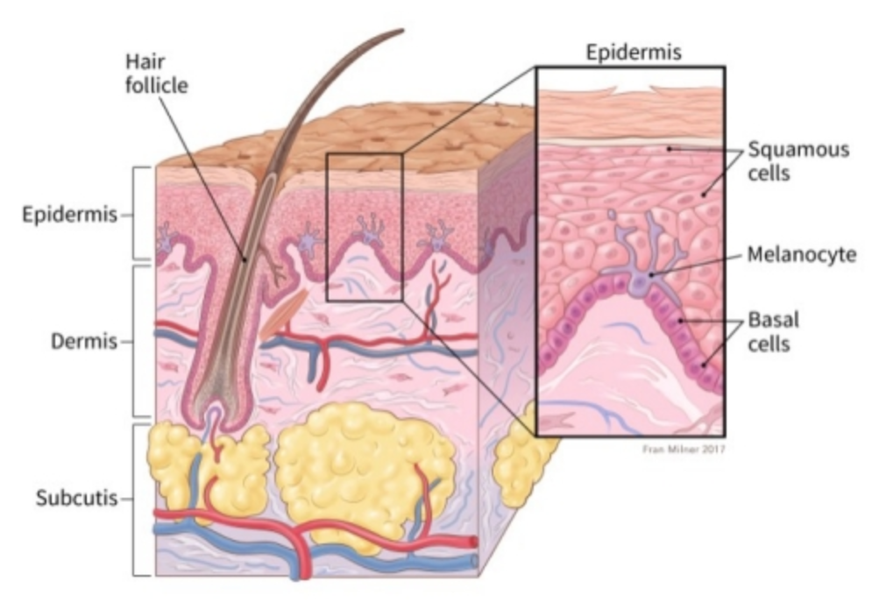
Basal Cell Carcinoma
Annual Skin Cancer Diagnosis in the US
Keratinocytes
American Cancer Society
Notes:
Basal Cell Carcinoma is the most prevalent skin cancer in the US with 4 million diagnosis a year. This cancer occurs in the basal layer of the epidermis which is the lowest layer of the epidermis consisting of keratinocyte stem cells. This cancer is most commonly expressed as lesions on sun-exposed areas of the body. This disease is of interest as it has a particularly high rate of reoccurrence even following successful treatment. Basal Cell Carcinoma is caused by uncontrolled activation of the hedgehog signaling pathway which is a critical pathway in development.
Basal layer contains keratinocytes which constantly divide and which moves them higher in the epidermis (Squamous cells). These cells are made up of keratin protein. There are also melanocytes in the skin because they are responsible for making melanin to give the skin its natural sunscreen.

Slide 3

Hedgehog Signaling Pathway
Atwood et al., 2012
Notes:
When the Hedgehog Signaling pathway is inactive, the G protein coupled receptor Patched (12 pass transmembrane protein receptor) inhibits the signal transducer Smoothened (7 pass transmembrane protein receptor). Additionally, Sufu or Supressor of Fused can inhibit the activation of GLI transcription factors. When a HH ligand, which are part of the the Hedgehog family of proteins, binds to the patched receptor, Patched no longer inhibits SMO so it moves into the cilium where it binds and inhibits SUFU. This allows for the release of GLI transcription factor so that it can move into the nucleus to begin to transcribe target genes and activate the pathway. This pathway occurs in the primary cilia of a cell which are critical in the epidermis for signal amplification during G1.
Hedgehog proteins control cell growth, survival, and fate, and pattern almost every aspect of the vertebrate body plan. These are classified into three classes, Desert Hedgehog, Indian Hedgehog and Sonic Hedgehog proteins.

Slide 4

Inhibition of SMO to treat BCC
Sharpe et al., 2015
Notes:
As a method for treating BCC, small molecule drugs such as vismodegib have been designed to inhibit smoothened. When smoothened is inhibited, the release of GLI transcription factors cannot occur and thus Hedgehog target genes cannot be transcribed. However, as I mentioned earlier this disease has a high rate of reoccurance, even with successful treatment with small molecule inhibitors. This occurs through two major phenomena. The first is the BCC can acquire resistance to SMO inhibitors thus causing a loss of SMO inhibitor Sufu and the gain of more transcription factors in the system. Thus allowing the pathway to remain on. Additionally, mutations in SMO have caused the drug to be ineffective in suppressing SMO and thus allowing the pathway to proceed as normal.
Both BCC resistance and SMO mutations have directed the attention of our lab to the GLI transcription factors downstream of smoothened to understand the overall pathway activation in BCC. There are three GLI transcription factorss; however, we are interested in GLI1 and GLI2 as they activate the Hedgehog Signaling pathway. Using the COSMIC database, our lab has compiled a list of recurrent GLI mutations and screened them for the activation of Hedgehog Signaling activity. In looking at the mutations that activate Hedgehog, they are all phosphosites which may be regulated by kinase activity.

Slide 5
Purpose
- Assess activation of the Hedgehog Signaling Pathway by kinases predicted to phosphorylate recurrent GLI mutation sites
Hypothesis
- MAP2K1/MEK1, PDHK and NEK1 which have been predicted to phosphorylate GLI mutation sites will cause activation of Hedgehog Signaling
Notes:
So this leads us to the purpose of this experiment which is to assess the activation of the HH signaling pathway by kinases predicted to phosphorylate recurrent GLI mutation sites.
My hypothesis is that three kinases predicted to phosphorylate these mutation sites: MAP2K1/MEK1, PDHK and NEK1 will cause the activation of Hedgehog Signaling.

Slide 6
Kinases Predicted to be Active at Recurrent GLI Mutations
GLI1/2 Recurrent Mutations that Hedgehog Activation
R100C
Use prediction databases to identify kinases
MAP2K1/MEK1
Select kinases candidates of interest
MAP2K1/MEK1
C177Y
E572K
G613C
R227C
G613C
PDHK
NEK1
BUB1
PAK6
CDK19
PDHK
NEK1
Notes:
To select the kinases to evaluate in this experiment, I began by compiling the list of GLI1/2 recurrent mutations that activate Hedgehog Signaling and a respresentitive amount can be seen here. Then using two prediction databases, I compiled a list of kinases that are predicted to be active within four residues of the region for each mutation. From there I selected the three kinase candidates of interest based on their role in cancer or Hedgehog Signaling, inhibitor availability, specificity and IC50 range.

Slide 7
Kinases Predicted to be Active at Recurrent GLI Mutations
Kinase | Significance | Inhibitor
Mitogen-Activated Protein Kinase 2 (MAP2K1/MEK1) | Melanoma and metastasis Stabilizes GLI and activates Hedgehog Signaling | Cobimetinib IC50 4.2 nM
Pyruvate Dehydrogenase Kinase (PDHK) | Regulates glycolysis Inhibition upregulates apoptosis | Dichloroacetic Acid IC50 81.03 mM
NIMA Related Kinase (NEK1) | Role in ciliogenesis Activates GLI and Hedgehog Signaling | Zinc05007751 IC50 3.4 μM
Notes:
The first was MAP2K1/MEK which is important in Melanoma and cancer metastasis and has also previously been shown to stabilize GLI and activate HH. Its inhibitor, Cobimetinib is a clinically used inhibitor of MAP2K1/MEK1 for melanoma patients with an IC50 of 4.2 nM
Wild Type 3T3—mouse fibroblast cell line and BCC cells-- were treated with drug at its inhibitor and three higher concentrations for 24 hours before extracting RNA and performing qPCR measuring GLI1 expression, or Hedgehog Signaling activation

Slide 8


MAP2K1/MEK1 inhibition does not impact Hedgehog Signaling Activation
Wild Type (3T3)
BCC
Notes:
Gli expression of RNA extracted from WT and BCC cells treated with drug for 24 hours.
Looking at GLI gene expression indicative of Hedgehog Pathway activation. We observe increased Gli expression in hedgehog conditioned serum starved media as expected because the Hedgehog pathway is specifically activated. However, between untreated and treated samples, not much change in GLI expression.
Outlier BCC (still outlier that whatever happened in that treatment condition Is just odd but with an experimental replicate it could go away, could also be a bimodal response where there is a different response to the drug based on its concentration)
Does drug work..need to see if it works in Knock down or if Western of a target gene can show decreased levels of phosphorylation

Slide 9
MAP2K1/MEK1 Affects Cell Proliferation at High Concentrations of Cobimetinib Inhibitor
Notes:
Measuring absorbance at 570 nM as a measure of BCC cell viability when treated with drug.—what does the absorbance mean—more absorabance—more viable cells!
Comparing the blue line (diluent only) to the other lines we do not see significant change in the absorbance at 570 nM with the exception of the 100 nM concentration during the last day of incubation. Overall, do not see a significant effect on the cell viability for BCC cells when treated with inhibitor

Slide 10
Kinases Predicted to be Active at Recurrent GLI Mutations
Kinase | Significance | Inhibitor
Mitogen-Activated Protein Kinase 2 (MAP2K1/MEK1) | Melanoma and metastasis Stabilizes GLI and activates Hedgehog Signaling | Cobimetinib IC50 4.2 nM
Pyruvate Dehydrogenase Kinase (PDHK) | Regulates glycolysis Inhibition upregulates apoptosis | Dichloroacetic Acid IC50 81.03 mM
NIMA Related Kinase (NEK1) | Role in ciliogenesis Activates GLI and Hedgehog Signaling | Zinc05007751 IC50 3.4 μM
Notes:
MAP2K1/MEK does not seem to have effect on Hedgehog Signaling pathway, so we can eliminate this kinase from our running
Next look at PDHK and why

Slide 11


Inhibition of PDHK by Dichloroacetic Acid does not reduce Hedgehog Signaling
Wild Type (3T3)
BCC
Notes:
See small increase in hedgehog treated 3T3 cells but at IC50 of 80 mM the Gli expression is low
BCC does not show much change with presence of inhibitor.

Slide 12
Treatment of BCC cells with PDHK inhibitor Dichloroacetic Acid does not affect cell survival
Notes:
Measuring absorbance at 570 nM as a measure of BCC cell viability when treated with drug.
Comparing the blue line (diluent only) to the other lines we do not see significant change in the absorbance at 570 nM. Overall, do not see a significant effect on the cell viability for BCC cells when treated with inhibitor

Slide 13
Kinases Predicted to be Active at Recurrent GLI Mutations
Kinase | Significance | Inhibitor
Mitogen-Activated Protein Kinase 2 (MAP2K1/MEK1) | Melanoma and metastasis Stabilizes GLI and activates Hedgehog Signaling | Cobimetinib IC50 4.2 nM
Pyruvate Dehydrogenase Kinase (PDHK) | Regulates glycolysis Inhibition upregulates apoptosis | Dichloroacetic Acid IC50 81.03 mM
NIMA Related Kinase (NEK1) | Role in ciliogenesis Mutations in kinase correlate to cancer | Zinc05007751 IC50 3.4 μM
Notes:
PDHK does not seem to be a promising target, however we could try to increase the range of drug treatment to see if there is an impact. However, the inhibitor we are using is a general acid so many different pathways might be impacted with the use of this drug. If we wanted to pursue this kinase we could knock out PDHK with short hairpin RNA or CRISPR to see if the drug is working specifically on its target and how its working.
Then look at the next kinase (NEK)

Slide 14


Inhibition of NEK1 affects Hedgehog Signaling Activation
Wild Type (3T3)
BCC
Notes:
See increase in expression of HH SS WT but see a reduction of the GLI expression when the drug is added. In the BCC cell line, we see some concentrations have decreased GLI expression, which is a positive result.

Slide 15
Treatment of BCC cells with NEK1 inhibitor Zinc05007751 does not affect cell survival
Notes:
Measuring absorbance at 570 nM as a measure of BCC cell viability when treated with drug.
Comparing the blue line (diluent only) to the other lines we do not see significant change in the absorbance at 570 nM. Overall, do not see a significant effect on the cell viability for BCC cells when treated with inhibitor

Slide 16
Kinases Predicted to be Active at Recurrent GLI Mutations
Kinase | Significance | Inhibitor
Mitogen-Activated Protein Kinase 2 (MAP2K1/MEK1) | Melanoma and metastasis Stabilizes GLI and activates Hedgehog Signaling | Cobimetinib IC50 4.2 nM
Pyruvate Dehydrogenase Kinase (PDHK) | Regulates glycolysis Inhibition upregulates apoptosis | Dichloroacetic Acid IC50 81.03 mM
NIMA Related Kinase (NEK1) | Role in ciliogenesis Mutations in kinase correlate to cancer | Zinc05007751 IC50 3.4 μM
Notes:
NEK Kinase seems to be the most impactful of the kinases tested, as presence of the inhibitor caused a reduction in GLI expression, thus suppressing GLI activation and showing NEK1 is important in this pathway

Slide 17
Future Directions
Increase exposure to SS/HH SS Conditions
Increase range of Inhibitor
Continue Kinase Screening
Cytotoxicity control
Confirm inhibitor target
Confirm NEK1 as Activator of HH Signaling
Investigate Mechanism of GLI Activation by NEK1
In vitro Kinase assay with GLI1 and NEK1
BUB1, PAK6, CDK19
GLI Activation with qPCR
Cell Survival
CO-IP of GLI1 and NEK1
Notes:
Moving forward, I would like to continue to pursue NEK1 as a Hedgehog Signaling Pathway activator. To begin, I would increase the incubation of cells in SS conditions. These cells were placed in SS conditions right before dosing, however, I would like to confirm that this interaction still occurs when the cells are serum starved for a day before treatment. This would likely increase the response we have observed in the Wild Type cells because the primary cilia would have time to form. I would increase the range of Zinc05007751 tested as the range in this experiment was narrow beginning with 3.4 uM and increasing to 10 uM. This will give us a better idea of the effect of this drug. Additionally, I want to provide a control for cytotoxicity by treating a mouse keratinocyte line with the drug and incubating for 6 days. This is crucial because the BCC cell line has gained resistance over time so we want to have a mimic for what this drug will do in vivo in a mouse experiment. After fine tuning these experimental conditions, I would like to confirm that the target for this drug is as expected by knocking down NEK1 using shRNA or CRISPR. I expect that the drug will not have an effect on GLI transcription when NEK1 is knocked down as it will not be able to act on its target.
Long term want to investigate if the NEK is activating Gli by doing an in vitro kinase assay using human recombinant NEK1 and GLI. Co-IP to see if they interact in biology
Also want to continue kinase screening with some of the other candidates I found to be promising in my initial screen such as BUB1, PAK6 and CDK19 and run the same experiments as demonstrated here where we look as GLI expression and cell survival!

Slide 18
Acknowledgements
The Atwood Lab
Rachel Chow
Emmanuel Dollinger
Tuyen Nguyen
Adam Stabell
Eric Tarapore
Kirsten Wong
Anna Andronicos
Scott Atwood, PhD
Cellular and Molecular Biology Gateway Program
Gary Roman
Eric Pearlman, PhD

